Slide 1


Cash Withdrawal Simplification
Syafriandi Armand Saleh - EDA Batch 6

Slide 2
Executive Summary
The process of cashing out the client's cash balance from the client's investment account (RDN) to the client's personal account currently depends on the interbank SLA especially if the accounts are managed in different banks.
This process involves the validation process on several items such as account validation, cash balance checking and validation, trading limit adjustment, approval and execution of the cash withdrawal itself by uploading money transfer instructions to any Bank's Cash Management System.
Improvement opportunities and challenges arise as some clients manage their personal accounts in different Banks as their RDN. This condition makes SLA highly dependent on the Bank's money transfer time window and also cost efficiency from the client's point of view. Also some validation processes still require human intervention to approve whether can be executed or not because of the client's receivables or client's outstanding order.
Blockchain thru smartcontract is considered as alternative solution for betterment SLA (zero down time, immutable, secure and no dependency on human or third party). This solution is considered as initial before integrating the solution with banking platform for more seamless services and future business opportunities

Slide 3


Current Problem (1)
BackOffice System
Client A
Account Mr. A at Bank 1
Account Mr. B at Bank 2
Account Mr. C at Bank 3
Account Mr. D at Bank 4
Account Mr. E at Bank 5
Account Mr. F at Bank 6
RDN bank 1
RDN bank 3
RDN bank 6
Client B
Client C
A
B
C
D
E
F
Client D
Personal Account
Client E
A
B
C
D
E
F
Front Office
System
Client F
Issue :
Batching process & time window limitation
Client cost concern
SLA (dependence on 3rd parties)
Lack of system integration
H2H for RDN
CMS 1
CMS 2
CMS 3
CMS 4
CMS 5
CMS 6
A
B
C
Bank 1
Bank 2
Bank 3
Bank 4
Bank 5
Bank 6
D
E
F

Slide 4
Proposed Solution
BackOffice System (Private Blockchain)
C
F
C
F
C
F
Client A
B
E
B
E
B
E
Client B
A
D
A
D
A
D
Client C
Omnibus Bank 1
Omnibus Bank 2
Omnibus Bank 3
Client D
Master Account
Front Office
System
Client E
Omnibus Bank 4
Omnibus Bank 5
Omnibus Bank 6
A
D
Client F
A
D
A
D
A
D
B
E
B
E
B
E
B
E
C
F
C
F
C
F
C
F
Proposed solution is :
Create blockchain solution for client cash withdrawal
Smart contract will use to validate the eligible cash balance, also trigger the Bank’s file instruction for fund transfer to client personal account
The smart contract will be used to predict the minimum bank balance that must be available based on the customer's cash withdrawal behavior model, and also run the process of replenishing the balance of funds at each bank.
H2H for RDN
CMS 1
CMS 2
CMS 3
CMS 4
CMS 5
CMS 6
A
B
C
Bank 1
Bank 2
Bank 3
Bank 4
Bank 5
Bank 6
D
E
F

Slide 5




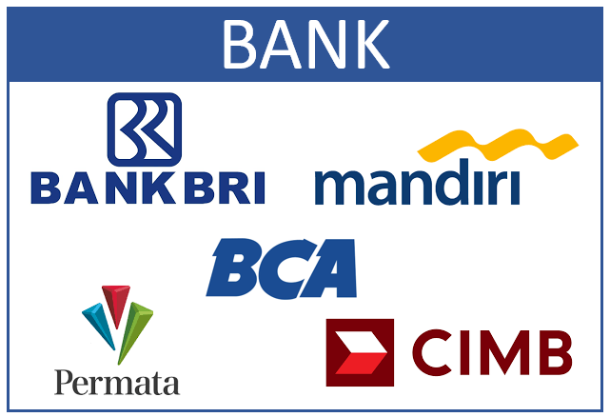
Data Flow Diagram
Custody Staff Entry Client Master Data
Client access services (transaction & cash withdrawal)
Finance Staff Upload Bank Trx
1st Phase of Project Scope

Slide 6
Expected Outcome (end in mind)
Client | Bank RDN | Bank Personal Account | Money Flow | Instruction | Bank Fee
A | 1 | 1 | 1 -> 1 | PB | No Fee
B | 1 | 2 | 1 -> 2 | Kliring/Online/RTGS | 5K - 15K
C | 1 | 3 | 1 -> 3 | Kliring/Online/RTGS | 5K - 15K
D | 3 | 4 | 3 -> 4 | Kliring/Online/RTGS | 5K - 15K
E | 6 | 5 | 6 -> 5 | Kliring/Online/RTGS | 5K - 15K
F | 6 | 6 | 6 -> 6 | PB | No Fee
Client | Bank RDN | Bank Personal Account | Money Flow | Instruction | Bank Fee
A | 1 | 1 | 1 -> 1 | PB | No Fee
B | 1 | 2 | 2 -> 2 | PB | No Fee
C | 1 | 3 | 3 -> 3 | PB | No Fee
D | 3 | 4 | 4 -> 4 | PB | No Fee
E | 6 | 5 | 5 -> 5 | PB | No Fee
F | 6 | 6 | 6 -> 6 | PB | No Fee
Output :
Bank’s Instruction File to be upload to CMS
Files create only for Bank RDN Only with multiple type of instruction
Output :
Smart contract will :
calculate eligible Bank balance of each client and synchronize it among nodes within the private block chain
Smart contract will create bank’s instruction file with PB instruction (PB is money transfer between account within the same bank)
Calculate replenishment fund daily for each bank as minimum fund balance.
Bank’s Instruction File to be upload to CMS

Slide 7
Why Using Blockchain
Blockchain is considered use as solution because :
More secure, to avoid misconduct of client or internal staff
Eliminate human dependency for check/review and approval
Zero downtime of services as data not store at single node, also data consistency can be secure due to consensus mechanism used in blockchain
This solution is consider as initial phase, and its possible to leverage further by integrating with other ecosystem in the future.
The blockchain will be used is Ethereum :
Most of private sector case utilize Ethereum
As blockhain platform ethereum can also be used for executing smart contract, not only executing financial transaction
Considered more mature than the latest generation (Cardano), hopefully many reference case are available for use.

